Slide 1
NLP Überblick & Grundlagen

Slide 2
Einführung in NLP

Slide 3
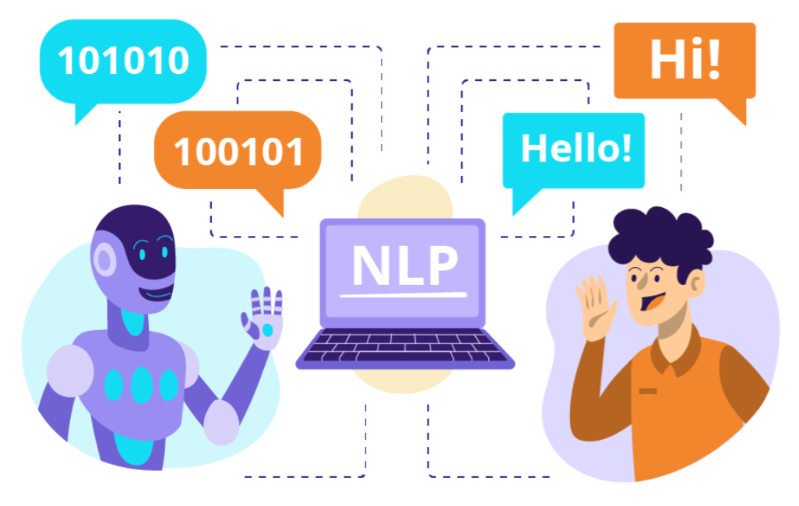
Was ist NLP?
NLP ist ein spezieller Bereich im Machine Learning, der sich darauf konzentriert, menschliche Sprache zu verstehen, zu interpretieren und zu erzeugen.
NLP überbrückt die Kluft zwischen menschlicher Kommunikation und Computerverständnis, indem es Interaktionen durch natürliche Sprache ermöglicht.
Das ultimative Ziel von NLP ist es, Computer zu befähigen, menschliche Sprache auf bedeutungsvolle und kontextuell passende Weise zu verarbeiten, zu verstehen und zu beantworten.
Notes:
NLP is a specialized domain within Machine Learning that focuses on understanding, interpreting, and generating human language.

Slide 4
Kurze Geschichte von NLP
1950er-1960er: Regelbasierte Systeme und frühe KI
1970er-1980er: Entwicklung ausgefeilterer statistischer Modelle
1990er-2000er: Aufstieg der Machine Learning Techniken
2010er-heute: Deep Learning und neuronale Netze revolutionieren NLP
Notes:
NLP has evolved a lot since the begging of it until our time…
Overall, the evolution of NLP showcases the journey from simple rule-based approaches to complex, data-driven models that harness the power of deep learning, continually pushing the boundaries of what machines can understand and generate in human language
In the 1950s and 1960s, the field began with rule-based systems, laying the groundwork for basic AI.
The 1970s and 1980s saw the development of more sophisticated statistical models, marking a shift towards data-driven approaches.
In the 1990s and 2000s, the rise of machine learning techniques further transformed NLP.
Since the 2010s, the advent of deep learning and neural networks has revolutionized the field, dramatically enhancing the capabilities of NLP systems.

Slide 5
Beispiele aus verschiedenen Epochen
Frühe regelbasierte Systeme: Systeme basierend auf handgeschriebenen Regeln
Beispiel: ELIZA (1966) – Ein einfacher Gesprächsagent
Statistische Methoden: Verwendung statistischer Modelle zum Lernen aus Daten
Beispiel: Hidden Markov Modelle (HMM) für Part-of-Speech-Tagging
Machine Learning in NLP: Algorithmen, die aus großen Datensätzen lernen
Beispiel: Naive Bayes oder SVM für Textklassifikation, SVD (Singulärwertzerlegung) für dichte Repräsentationen (Embeddings)
Deep Learning in NLP: Neuronale Netze, die Textdaten verarbeiten
Beispiel: Transformer-Modelle wie BERT und GPT
Notes:
Here some examples…

Slide 6
NLP Anwendungsfälle
1. Mensch-Computer-Interaktion
Ermöglicht nahtlose Kommunikation zwischen Menschen und Maschinen durch natürliche Sprache:
Virtuelle Assistenten: Alexa, Siri, Google Assistant, Cortana
Chatbots: Kundenservice-Bots in Banken (z.B. „Erica“ von Bank of America), E-Commerce (z.B. Shopify-Chatbots), Gesundheitswesen (z.B. Babylon Health)
Conversational AI: ChatGPT und ähnliche Modelle
Spracherkennung und Sprachsteuerung: Tools wie Google Live Transcribe
Notes:
Now we now what NLP is, let's see some use cases. First: Human-computer interaction.
Virtual Assistants: They employ NLP to understand queries and generate relevant responses, facilitating a conversational interface between users and technology.
Chatbots: Utilize NLP to interact with users in customer service scenarios.
Conversational AI: Use advanced NLP techniques to comprehend and generate human-like text responses.
Speech-to-Text and Voice Control: Can transcribe spoken language in real-time into text, making communication more accessible for those with hearing impairments.

Slide 7
NLP Anwendungsfälle
2. Automatisierung
Vereinfachung von Prozessen und Verringerung manueller Arbeit bei sprachbezogenen Aufgaben:
Dokumentenverarbeitung: Automatische Extraktion von Rechnungsdaten, Vertragsanalyse und Compliance-Checks für Branchen wie Finanzen, Versicherung und Recht
E-Mail-Verwaltung: Automatisches Sortieren, Zusammenfassen und Beantworten von E-Mails
Dateneingabe und Zusammenfassung: Extraktion wichtiger Informationen aus Lebensläufen, Forschungsarbeiten und anderen strukturierten/unstrukturierten Daten
Übersetzung und Lokalisierung
Notes:
Second: Automation.
Document Processing: NLP technologies can analyze documents for relevant information, such as extracting payment details from invoices or identifying terms and conditions within contracts.
Email Management: This reduces the time spent on email management and enhances productivity.
Data Entry and Summarization: NLP algorithms can analyze text documents to pull out essential details, such as qualifications from resumes or key findings from research papers.
Translation and Localization: Translation enables global communication and accessibility. Localization adapt the content to fit cultural nuances and preferences, making it more relevant and relatable to target audiences.

Slide 8
NLP Anwendungsfälle
3. Erkenntnisse
Erkennen wertvoller Informationen und Muster aus riesigen Textdatensätzen:
Sentiment-Analyse: Analyse öffentlicher Meinungen zu Wahlen, Marken oder Ereignissen via Social Media, Umfragen und Bewertungen
Trend-Erkennung: Erkennen aufkommender Themen in Kundenfeedback oder Online-Diskussionen
Marktforschung: Gewinnung von Wettbewerbsinformationen aus Foren, Nachrichten oder Marktberichten
Gesundheitliche Erkenntnisse: Auswertung medizinischer Aufzeichnungen und Forschung zur Trendanalyse und Unterstützung klinischer Entscheidungen
Notes:
Third: Insights.
Sentiment Analysis: For instance, analyzing tweets about a political event can provide insights into public sentiment regarding candidates or policies.
Trend Identification: By analyzing sentiment and frequency of discussions, companies can proactively address concerns and capitalize on emerging trends.
Market Research: This information helps organizations refine their strategies to enhance their position in the market, identify opportunities for growth, or benchmark their offerings against competitors' products and services.
Healthcare Insights: This analysis can help in recognizing prevalent health issues within specific populations, supporting clinical decision-making, and improving patient care through informed strategies based on derived insights.

Slide 9
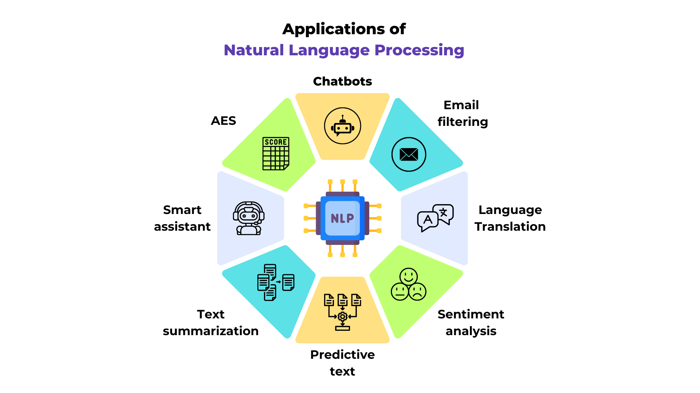
Weitere NLP Anwendungsfälle
Notes:
There are more applications of NLP, if you want you can check them by yourself…

Slide 10
Reale industrielle NLP-Anwendungsfälle
Klassifikation von Hunderttausenden Websites nach Technologie und Branche
Automatisierung der vollständigen Schadenabwicklung bei Versicherungen
Dokumentklassifikation basierend auf Risiko und Schadensursachen
Extraktion wichtiger Entitäten wie Namen, Firmen, Adressen (Named Entity Recognition, NER)
Prüfung, ob eine Versicherungspolice zum Schaden passt
Verstehen von Rechnungen mit verschiedenen Tabellenformaten
Markenschutz – Identifikation von rechtsverletzenden Websites

Slide 11
NLP Arbeitsablauf

Slide 12
Unterschiedliche Schritte in einem NLP-Problem
Datenerfassung: Sammlung von Textdaten
Annotation: Daten kennzeichnen
Datenvorverarbeitung: Text bereinigen und für Analyse vorbereiten
Merkmalextraktion: Umwandlung von Text in numerische Merkmale
Modelltraining: Anwendung von Algorithmen auf Textdaten
Modellevaluation: Bewertung der Leistung von NLP-Modellen
Der NLP-Prozess ist zyklisch und iterativ. Die Qualität der Daten und Annotationen beeinflusst den Erfolg der folgenden Schritte.
Notes:
The pipeline of natural language processing (NLP) involves several interrelated steps that collectively contribute to the development of effective NLP models. The interaction among these steps is cyclical and iterative. Here’s an overview of how these steps interact…
Data Acquisition: The quality and quantity of data collected here directly impact the success of subsequent steps in the pipeline.
Annotation: Proper annotation is crucial for training models as it provides the ground truth for supervised learning algorithms. The accuracy of the annotations can influence model performance significantly
Data Preprocessing: Effective preprocessing improves the data quality, ensuring that the algorithms can focus on the relevant linguistic features without noise. It sets the foundation for accurate feature extraction
Feature Extraction: High-quality feature sets facilitate better model training, capturing intricate aspects of the text.
Model Training: The model learns patterns in the training data, relying on the quality of the features and annotations. The effectiveness of model training determines the model's ability to generalize to new, unseen data
Model Evaluation: The insights gleaned from evaluation inform whether the model meets the desired objectives or if additional adjustments are necessary, such as refining features, enhancing preprocessing steps, or tweaking the model architecture.

Slide 13
Unterschiedliche Schritte in einem NLP-Problem
Wir haben Textdaten
Vorverarbeitung
Merkmale extrahieren
Modell trainieren
Modell bewerten
Annotation (falls nötig)

Slide 14
Datenerfassung
Sammeln von Textdatenquellen:
Web Scraping: Blogs, Foren, Social Media, Webseiten
Öffentliche Datensätze: Open Repositories (z.B. Kaggle, UCI, Hugging Face Datasets)
APIs: Social Media APIs (z.B. Twitter API), Nachrichten APIs
Interne/Proprietäre Daten: Kundenbewertungen, E-Mails, Chat-Logs
Korpora aus Literatur: Bücher, Forschungsarbeiten, Wikipedia
Herausforderungen:
Datenqualität: Rauschen oder unvollständiger Text (meist gut handhabbar)
Rechtliche/Ethische Aspekte: Datenschutz, Urheberrecht
Notes:
A NLP project need data to process, first step then is Data Acquisition. There are different sources from where you can collect data and challenges associated to this.
Web Scraping: Utilizing automated tools to extract data from various online platforms, including blogs, forums, social media, and websites.
Public Datasets: Utilizing open repositories that offer datasets for research and analysis purposes, such as those found on platforms like Kaggle, UCI Machine Learning Repository, and Hugging Face Datasets.
APIs: APIs allow for real-time data collection and are often structured, simplifying the analysis and integration process.
Documents from Different Organizations: Accessing text data from reports, white papers, and publications released by various organizations.
Challenges in Collecting Text Data:
Data Quality: While the quality is generally manageable, ensuring a clean, relevant dataset is crucial for accurate analysis and better results.
Legal/Ethical Considerations: Adhering to legal frameworks such as GDPR and obtaining necessary permissions is critical to avoid legal repercussions and maintain ethical standards in data collection.

Slide 15
2. Annotation
Was ist Annotation?
Rohtext mit Labels versehen, um strukturierte Datensätze für Machine Learning zu erstellen.
Häufige Annotationstypen:
Textklassifikation: Sentiment, Thema, Spam-Erkennung
Named Entity Recognition (NER): Erkennung von Namen, Daten, Orten
Part-of-Speech (POS) Tagging: Grammatische Wortarten zuordnen
Notes:
Annotation is the process of adding labels or tags to raw text data in order to create structured datasets that can be used for machine learning tasks.
This step is crucial in supervised learning settings, where models require labeled examples to learn patterns and make predictions.
Through annotation, unstructured text is transformed into a format that facilitates the training and evaluation of machine learning algorithms.
Annotation types:
Text Classification: Used in sentiment analysis for products or services, categorizing news articles, and identifying spam emails.
Named Entity Recognition (NER): Involves identifying and classifying key entities in text, such as names of people, organizations, locations, dates, and other relevant terms. Used in information extraction, search engines, and to enhance chatbots by recognizing specific entities mentioned in conversations.
Part-of-Speech (POS) Tagging: Involves assigning grammatical tags to individual words in a sentence, categorizing them as nouns, verbs, adjectives, adverbs, etc. Critical for understanding the syntactic structure of sentences, aiding in tasks like parsing, information retrieval, and improving the accuracy of other NLP applications.

Slide 16
Annotationsmethoden:
Manuelle Annotation: Menschen mit Tools wie Label Studio, Prodigy oder firmeneigenen Lösungen
Crowdsourcing: Plattformen wie Amazon Mechanical Turk, CrowdFlower
Herausforderungen:
Subjektivität bei der Kennzeichnung
Konsistenz der Annotatoren
Kosten und Zeitaufwand
Notes:
Let’s see some annotation methods and challenges…
Manual Annotation: This method involves human annotators who use specific tools to label the data. Annotators review the text and apply the appropriate labels or tags based on the guidelines provided. T
Crowdsourcing: This method leverages online platforms to distribute annotation tasks to a large group of people, often resulting in a more extensive and diverse range of inputs.
Platforms Services: Services like Amazon Mechanical Turk and CrowdFlower (now known as Figure Eight) allow organizations to post annotation tasks that can be completed by distributed workers, which can expedite the annotation process and reduce costs.
Challenges
Subjectivity in Labeling: For example, one annotator might label a sentiment as positive while another may label it as neutral due to differing interpretations. High subjectivity can negatively affect the quality of the annotated dataset, which in turn impacts the performance of machine learning models trained on this data.
Annotator Consistency: Inconsistencies can require additional rounds of quality checks and re-annotations, increasing the time and resources needed for the project.
Cost and Time Requirements: Budget constraints and project timelines may limit the scale of annotation efforts, forcing compromises on data quality or quantity.

Slide 17
Vorverarbeitung

Slide 18
3. Vorverarbeitung
Die Vorverarbeitung ist der erste Schritt im NLP, bei dem der Rohtext in ein sauberes, strukturiertes und für die Analyse geeignetes Format umgewandelt wird.
Welche Bedeutung hat die Textvorverarbeitung?
Sie entfernt Rauschen und bereitet den Text für die Modellierung vor.
Der Umfang der erforderlichen Vorverarbeitung hängt von der Art des verwendeten maschinellen Lernmodells ab.
Als Faustregel gilt, dass einfachere Modelle mehr Vorverarbeitung benötigen, während komplexere Modelle wie Deep Learning-Modelle (CNNs, LSTMs, Transformers) weniger Textvorverarbeitung erfordern.
Notes:
Text preprocessing is a crucial initial step in natural language processing (NLP) that transforms raw text into a clean and structured format, making it suitable for analysis and modeling.
Different machine learning models may require different preprocessing techniques based on their complexity.
Aligning preprocessing steps with the model type can enhance the model's ability to learn from data.
For example, simpler models may need extensive preprocessing to improve interpretation, while complex models like deep learning architectures (e.g., CNNs, LSTMs, Transformers) can often cope with less preprocessing due to their ability to learn hierarchical representations.

Slide 19
Je nach verwendetem Modell gibt es unterschiedliche Techniken für die Vorverarbeitung.
In einem typischen NLP-Problem werden jedoch üblicherweise folgende Schritte in dieser Reihenfolge angewendet:
Textreinigung (aufgabenspezifisch)
Tokenisierung
Stoppwortentfernung (aufgabenspezifisch)
Stemming (aufgabenspezifisch) / Lemmatisierung (aufgabenspezifisch)
„Aufgabenspezifisch“ bedeutet, dass diese Techniken nicht immer notwendig sind; ihr Einsatz hängt vom Modell und der jeweiligen Aufgabe ab.
In den folgenden Folien werden wir jede dieser Techniken im Detail genauer betrachten.
Notes:
In a typical NLP problem, one expects to see the following techniques in the following order:
1st. Text Cleaning (Task-specific): This initial step involves removing any unwanted characters, symbols, or irrelevant information from the text (e.g., HTML tags, special characters). It's tailored based on the specific requirements of the task, making it task-specific.
2nd. Tokenization: After cleaning, the text is broken down into smaller units (tokens), such as words or sentences. This is an essential step that prepares the data for subsequent processing and analysis.
3rd. Stop-Words Removal (Task-specific): In this step, common words that add little meaning (like "and," "the," "is") are removed from the tokens. Again, this decision can depend on the task; some tasks might still require these words to understand context better.
4th. Stemming (Task-specific) / Lemmatization (Task-specific): Lastly, words can be reduced to their root forms using either stemming or lemmatization, depending on the needs of the task. Stemming is more about reducing words to their base forms, often resulting in non-dictionary terms, while lemmatization focuses on producing valid words based on their meanings.
This list of steps reflects the typical flow of preprocessing steps in NLP, while also emphasizing that certain techniques may be applied based on the specific requirements of the task at hand. This approach helps create a clean, structured dataset that fosters effective analysis and modeling.

Slide 20
3.1 Vorverarbeitung: Textbereinigung
Kleinschreibung
Original: „The Book Was Amazing!“
Kleingeschrieben: „the book was amazing!“
Entfernen von Satzzeichen
Original: „Hello, world!“
Ohne Satzzeichen: „Hello world“
Entfernen von Zahlen
Original: „I have 2 cats and 3 dogs.“
Ohne Zahlen: „I have cats and dogs.“
Notes:
Text cleaning is an essential step within Preprocessing because it helps to standardize text data, preparing it for further analysis and modeling. By ensuring the text is in a consistent format, these techniques enable more effective natural language processing.
Lowercasing the Data: This step involves converting all characters in the text to lowercase to ensure uniformity, as "The" and "the" would be treated as different words otherwise.
Removing Punctuations: This step removes punctuation marks from the text, which may not contribute to the analysis, thus simplifying the data.
Removing Numbers: This technique removes numerical values from the text, as they may not carry significant meaning for certain NLP tasks, helping to reduce noise.

Slide 21
Entfernen von überflüssigen Leerzeichen
Original: "Hello world! " Ohne Extra Space: "Hello world!"
Entfernen von Emojis
Original: "I love pizza 🍕!"
Ohne Emojis: "I love pizza!"
Entfernen von Emoticons
Original: "I'm happy :)"
Ohne Emoticons: "I'm happy"
Entfernen von Kontraktionen
Original: "I can't go there."
Ohnet Contractions: "I cannot go there."
Auch hier gilt: Diese Reinigungsstrategien hängen vom verwendeten Modell ab.
Bei fortgeschritteneren Modellen wie Transformern kann es sogar vorteilhaft sein, die Daten möglichst unverändert zu lassen und auf eine intensive Reinigung zu verzichten.
Notes:
Complement Material
Removing Extra Space This step eliminates any unnecessary spaces before or after the text, as well as multiple consecutive spaces between words, ensuring a clean and uniform string.
Removing Emojis: This technique removes emojis from the text, which may not be relevant for certain NLP analyses, thereby reducing noise and focusing on the textual content.
Removing Emoticons: Similar to emoji removal, this step eliminates emoticons from the text to streamline analysis, as they may not provide substantial information in most NLP tasks.
Removing Contractions: Contractions are expanded to their full forms (e.g., "can't" becomes "cannot") to enhance understanding and reduce ambiguity in language processing.

Slide 22
3.2 Tokenisierung
Tokenisierung ist der Prozess, Text in einzelne Einheiten wie Wörter oder Sätze aufzuteilen. Dies ist einer der ersten Schritte, um einer Maschine das Verstehen von Text zu erleichtern, indem der Text in kleinere Einheiten zerlegt wird.
Arten der Tokenisierung:
Wort-Tokenisierung: Aufteilung des Textes in Wörter
Satz-Tokenisierung: Aufteilung des Textes in Sätze
Subwort-Tokenisierung: Fortgeschrittene Methode, bei der der Text in Subwort-Einheiten zerlegt wird
Zeichen-Tokenisierung: Aufteilung des Textes in einzelne Zeichen
Notes:
Tokenization is the process of breaking down text into individual units, known as tokens. This step is crucial for allowing machines to understand and process text by converting it into smaller, manageable entities. By chunking the text, models can analyze the components more effectively.
Word Tokenization: This method involves splitting the text into individual words, typically by identifying spaces and punctuation marks.
Sentence Tokenization: In this approach, the text is divided into sentences based on punctuation marks such as periods, exclamation points, and question marks.
Sub-word Tokenization: This more advanced technique breaks words into smaller units, or sub-words, which can help with handling vocabulary issues and morphological variations in languages.
Character Tokenization: This method involves splitting text down to individual characters, which can be useful for certain applications such as language modeling or dealing with languages that have complex characters.
Tokenization is a fundamental text preprocessing step in NLP, enabling models to analyze text at various granular levels, be it words, sentences, sub-words, or characters. Choosing the appropriate type of tokenization depends on the specific requirements of the analysis or the machine learning model being used.

Slide 23
Beispiel:
Input: "Hello world! NLP is exciting."
Word-Tokens: ["Hello", "world", "!", "NLP", "is", "exciting", "."]
Satz-Tokens: ["Hello world!", "NLP is exciting."]
Zeichen-Tokens: ["H", "e", "l", "l", "o", " ", "w", "o", "r", "l", "d", "!", " ", "N", "L", "P", " ", "i", "s", " ", "e", "x", "c", "i", "t", "i", "n", "g", "."]
Notes:
Here an example…

Slide 24
3.3 Stop-Wort-Entfernung
Stoppwörter sind häufige Wörter, die meist wenig bedeutungsvolle Information tragen (z. B. „und“, „der“, „ist“). Das Ziel der Entfernung von Stoppwörtern ist es, die Dimensionalität der Daten zu reduzieren und den Fokus stärker auf aussagekräftige Wörter zu legen.
Beispiel: Eingabe: „This is an example of stop words removal.“ Ausgabe: [„example“, „stop“, „words“, „removal“]
Wichtig ist, dass die Entfernung von Stoppwörtern gut bei einfachen und niedrigstufigen Modellen funktioniert. Bei komplexeren Modellen hingegen möchte man sie häufig behalten.
Notes:
Stop words are common words in a language that generally do not carry substantial meaning on their own. These often include conjunctions, articles, and prepositions, such as "and," "the," "is," "in," and "on."
Removing stop words helps reduce the number of unique tokens in the dataset, simplifying the analysis and decreasing computational overhead. By eliminating these common words, the resulting dataset highlights more meaningful terms that contribute to the overall understanding of the text.
Stop words removal is especially beneficial for lower-level models. While stop words removal is a common preprocessing technique in NLP to refine datasets and focus on meaningful content, its utility must be evaluated based on the complexity of the model being used. In many cases, advanced models may benefit from retaining stop words to capture more nuanced textual relationships.

Slide 25
3.4. Stemming
Stemming reduziert Wörter auf ihre Stammform, indem Endungen entfernt werden. Es gibt verschiedene Algorithmen zum Stemming: Porter Stemmer
Snowball Stemmer
Beispiel: Eingabe: „running“, „runner“, „ran“
Ausgabe: „run“
Notes:
Stemming is the process of reducing words to their base or root form by removing suffixes (and sometimes prefixes). The goal of stemming is to normalize different forms of a word so that they can be treated as equivalent, allowing for more effective text analysis.
There are several algorithms commonly used for stemming, including:
Porter Stemmer: One of the most widely used stemming algorithms. It uses a series of heuristic rules to iteratively remove suffixes from words.
Snowball Stemmer: An improvement over the Porter Stemmer, it supports multiple languages and incorporates a more robust set of rules for suffix removal.
While stemming provides simplicity and performance benefits, it may sometimes lead to non-dictionary terms or truncations that are less interpretable, which is important to consider depending on the specific requirements of the analysis.

Slide 26
Die Grundidee hinter Stemming ist, verschiedene Wortformen zusammenzufassen, damit sie als ein einziges Element analysiert werden können. Das ist besonders nützlich bei Aufgaben wie Suchmaschinen, Text Mining und Informationsabruf. Wenn unsere Modelle nicht fein genug sind, um die sprachlichen Nuancen zu erfassen, wozu dann verschiedene Varianten desselben Konzepts wie „running“ unterscheiden? Stattdessen können wir sie alle zusammenfassen und uns nur auf den Wortstamm konzentrieren.
Ein weiteres Beispiel: Ursprüngliche Wörter: „analyze“, „analyzing“, „analyzed“, „analyzes“, „analysis“
Gestemmte Form: „analyz“
Notes:
The primary intuition behind stemming is to group together different morphological forms of a word so that they can be analyzed as a single unit. This is particularly beneficial in various NLP tasks, including:
Search Engines: When a user searches for a term, stemming allows the search engine to retrieve all relevant documents containing different forms of that word, enhancing the search experience.
Text Mining: By consolidating related terms, stemming allows for more effective analysis of text by reducing vocabulary size and focusing on core meanings.
Information Retrieval: Stemming helps improve retrieval accuracy by ensuring that all variants of a term are treated as equivalent, ensuring comprehensive results.
For less sophisticated models that may not effectively capture the nuanced meanings of language, retaining multiple forms of the same word (e.g., "running," "ran," and "runner") could lead to diluted analysis. By focusing on the stem, which represents the core concept, we simplify the data while still conveying key information.
Stemming is a practical NLP approach that aids in grouping different forms of a word to facilitate analysis. By focusing on the stem, simpler models can avoid complications arising from variations in language, ultimately leading to more effective outcomes in text processing tasks.

Slide 27
3.4.B Lemmatisierung
Lemmatisierung reduziert Wörter auf ihre Grund- oder Wörterbuchform und berücksichtigt dabei den Kontext. Vergleich mit Stemming: Lemmatisierung ist genauer als Stemming, benötigt aber mehr Rechenleistung.
Beispiel: Eingabe: „better“, „running“
Ausgabe: „good“, „run“
Im obigen Beispiel ist „good“ die lemmatisierte Form von „better“, weil hier das zugrundeliegende Konzept erfasst wird. Stemming erreicht diese Genauigkeit nicht.
Notes:
Lemmatization is the process of reducing words to their base or dictionary form (lemma), taking into account the context and meaning of the words. It uses a more sophisticated approach compared to stemming, often relying on vocabulary and morphological analysis of words.

Slide 28
3.4.C Stemming vs Lemmatisierung
Stemming Vorteile:
Schnell, einfach
Nachteile:
Kann nicht-wörterbuchmäßige Formen erzeugen, z. B. „analyz“
Lemmatisierung Vorteile:
Liefert sinnvolle Grundformen
Nachteile:
Langsamer, benötigt Kontext
Wenn möglich, solltest du Lemmatisierung bevorzugen!
Notes:
Lemmatization is generally more accurate than stemming because it considers the word's context and its meaning, ensuring that the output is a valid word.
Lemmatization tends to be computationally heavier than stemming, as it often requires a lookup in a dictionary or lexical database to determine the correct base form

Slide 29
Andere Vorverarbeitungsschritte
Je nach NLP-Aufgabe und verwendetem Modell können weitere Schritte im Prozess hinzukommen.
Diese Liste ist nicht verpflichtend, sondern soll dir nur einen Eindruck davon vermitteln, was möglich ist.
Im praktischen Teil werden wir diese Techniken dann direkt anwenden.

Slide 30
Merkmalextraktion

Slide 31
4. Merkmalextraktion
Feature-Extraktion: Bezeichnet den Prozess, rohe Textdaten in numerische Merkmale umzuwandeln, die als Eingabe für Machine-Learning-Algorithmen verwendet werden können. Diese Transformation ermöglicht es Modellen, Text zu verstehen und zu analysieren, sodass sie Aufgaben wie Klassifikation, Clustering oder Regression durchführen können.
Vektorisierung: Eine spezielle Form der Feature-Extraktion, bei der Wörter, Phrasen oder ganze Dokumente in numerische Vektoren umgewandelt werden. Diese Vektoren sind oft mehrdimensionale Repräsentationen, die die wichtigen Eigenschaften der Textdaten erfassen.
Notes:
After preprocessing the data we can transform the raw data into numerical features…
Vectorization is a key concept in this step…

Slide 32
Vectorization
Stell dir vor, wir haben folgenden Text: „The quick brown fox jumped over the lazy dogs. It was a sunny day in the forest.“
Nach der Vorverarbeitung entsprechend dem, was wir gelernt haben, sieht unser Beispiel dann so aus – eine Liste von Tokens (hier entspricht ein Token einem Wort):
sample = ["quick", "brown", "fox", "jump", "over", "lazy", "dog", "sunny", "day", "forest"]
Können wir das so direkt in ein beliebiges ML-Modell einspeisen?
Antwort: NEIN!

Slide 33
Vectorization
Wir müssen die Liste der Tokens in Zahlen umwandeln. Modelle verstehen nur Zahlen.
Es gibt verschiedene Techniken, um vorverarbeitete Texte zu vektorisieren:
Bag of Words (BoW)
TF-IDF (Term Frequency-Inverse Document Frequency)
Word Embeddings (z. B. Word2Vec, GloVe) oder Embedding-Schichten in neuronalen Netzwerken.
Notes:
There are various techniques for vectorizing such preprocessed texts:
Bag-of-Words (BoW) represents text by counting the frequency of each word in a document while ignoring the order. Each unique word corresponds to a dimension in a feature vector, and the vector consists of counts or binary indicators of the presence of words.
TF-IDF weighs the frequency of words in a document by how often they appear across all documents, highlighting words that are more informative. Similar to BoW, but instead of raw counts, the vectors contain values calculated based on the TF-IDF formula, providing a more nuanced representation of text documents.
Word Embeddings: Techniques like Word2Vec, GloVe, and FastText create dense vector representations of words based on their contexts. Words with similar meanings have similar vector representations.Each word is represented as a dense vector, often in a lower-dimensional space compared to the sparse representations of BoW or TF-IDF.
The choice of technique depends on the task, data characteristics, and the complexity of the model being employed.

Slide 34
4.1 Bag of Words (BoW) Beispiel
1. Vorverarbeitung und Tokenisierung des Textes
Probe 1: ["the", "cat", "sat", "on", "the", "mat"]
Probe 2: ["the", "dog", "barked"]
Probe 3: ["the", "cat", "and", "dog", "played"]
2. Identifizieren Sie alle eindeutigen Token (Wörter) im gesamten Datensatz (Corpus)
Dies bildet das Vokabular.
Vokabular: ["the", "cat", "sat", "on", "mat", "dog", "barked", "and", "played"]
3. Vektoren für jedes Textmuster erstellen
Für jede Textprobe wird ein Vektor erstellt, der die Vorkommen der einzelnen Wörter aus dem Vokabular zählt.
Probe 1: ["the", "cat", "sat", "on", "the", "mat"]
Vector: [2, 1, 1, 1, 1, 0, 0, 0, 0]
(2 occurrences of "the", 1 of "cat", 1 of "sat", etc.)
Probe 2: ["the", "dog", "barked"]
Vector: [1, 0, 0, 0, 0, 1, 1, 0, 0]
(1 occurrence of "the", 1 of "dog", 1 of "barked")
Probe 3: ["the", "cat", "and", "dog", "played"]
Vector: [1, 1, 0, 0, 0, 1, 0, 1, 1]
(1 occurrence of "the", 1 of "cat", 1 of "dog", etc.)

Slide 35
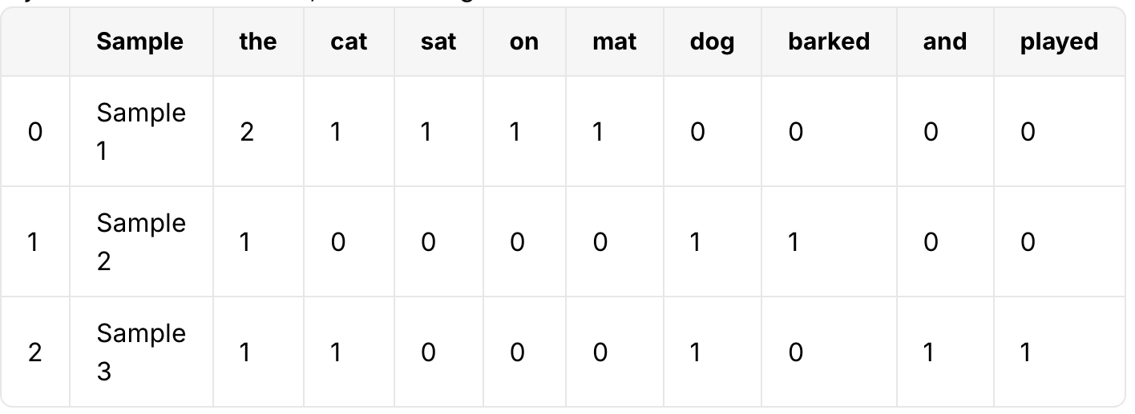
Abschließend werden die einzelnen Vektoren zu einer Merkmalsmatrix zusammengefügt, wobei jede Zeile eine Stichprobe und jede Spalte ein Wort im Vokabular repräsentiert.
Notes:
The Bag-of-Words model effectively represents text data by counting the frequency of each word in a sample, creating a structured numerical representation that can be used for various machine learning tasks.
The result is a feature matrix where each row corresponds to a document and each column corresponds to a unique word from the corpus. By using this representation, models can analyze and recognize patterns in the text data based on word occurrences.

Slide 36

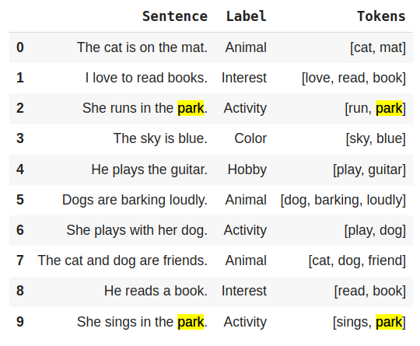
Bag of Words (BoW)
Angenommen, wir haben den linken Datensatz.
Wir haben ihn vorverarbeitet und für jede Stichprobe die Tokens ermittelt.
Die Idee von Bag of Words (BoW) ist es, jeder Stichprobe einen Vektor zuzuweisen, der die Häufigkeit der verschiedenen Tokens anzeigt.
Dabei wird ein Vokabular aus allen einzigartigen Wörtern im Korpus erstellt und anschließend für jedes Dokument die Anzahl der Vorkommen jedes Wortes gezählt.

Slide 37
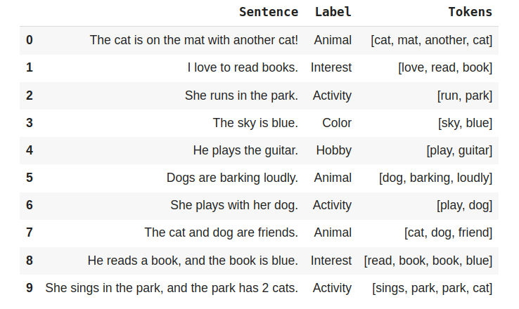
Bag of Words (BoW)
Vokabular einzigartiger Wörter
['another', 'barking', 'blue', 'book', 'cat', 'dog', 'friend', 'guitar', 'loudly', 'love', 'mat', 'park', 'play', 'read', 'run', 'sings', 'sky']

Slide 38
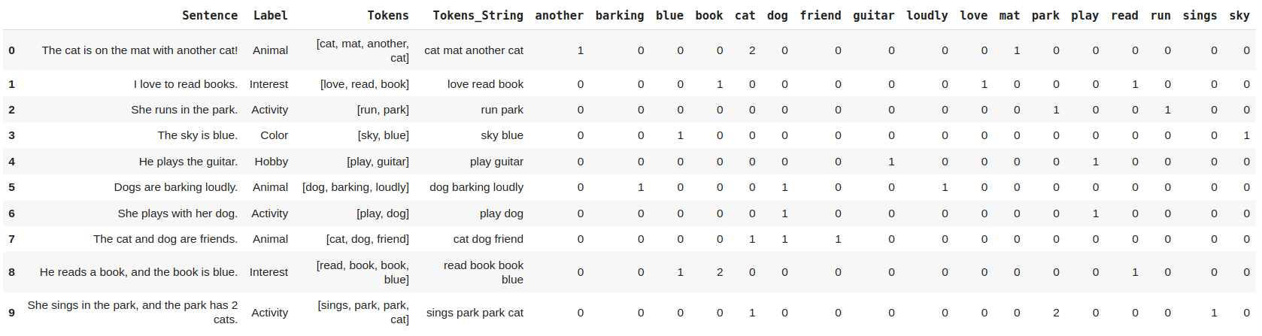
Bag of Words (BoW)

Slide 39
Bag of Words (BoW)
Wie du gesehen hast, berücksichtigt BoW die Wortreihenfolge nicht.
Wie der Name schon sagt, ist es eine „Tüte voller Wörter“. Wir packen die wichtigen Wörter in diese Tüte und setzen je nach Position im Wörterbuch eine 1 unter ein Wort, wenn es einmal vorkommt, eine 2, wenn es zweimal vorkommt, und so weiter bei mehrfachen Vorkommen.
BoW-Vektoren repräsentieren für uns jedes Dokument, und wir können mit ihnen statt mit dem reinen Text arbeiten.
Das ist eine Möglichkeit der Vektorisierung, manchmal auch Featurisierung genannt.

Slide 40
4.2 Begriffshäufigkeit - Inverse Dokumenthäufigkeit (TF-IDF)
Term Frequency-Inverse Document Frequency (TF-IDF) ist eine statistische Maßzahl, die die Bedeutung eines Wortes in einem Dokument im Verhältnis zu einem gesamten Korpus bewertet. Sie balanciert die Häufigkeit eines Wortes in einem bestimmten Dokument (Term Frequency) mit seiner Häufigkeit über alle Dokumente hinweg (Inverse Document Frequency). Dadurch werden Wörter hervorgehoben, die mehr informative Aussagekraft besitzen, während häufige, wenig aussagekräftige Begriffe abgewertet werden.
Bestandteile von TF-IDF:
Term Frequency (TF): Die Anzahl, wie oft ein Begriff in einem Dokument vorkommt, geteilt durch die Gesamtanzahl der Begriffe im Dokument. Sie zeigt, wie häufig ein Wort in einem bestimmten Text erscheint.
Inverse Document Frequency (IDF): Ein Maß dafür, wie viel Information ein Wort liefert, berechnet als Logarithmus aus der Gesamtanzahl der Dokumente geteilt durch die Anzahl der Dokumente, die den Begriff enthalten. Sie reflektiert die Bedeutung eines Begriffs im gesamten Korpus.
Notes:
We can also use TF-IDF in order to extract features…
TF-IDF works quantifying the importance of a word in a document relative to a collection of documents, emphasizing unique words in specific texts while penalizing common ones. Allowing for the identification of relevant features in text data that can improve tasks such as information retrieval, text classification, and natural language processing by focusing on terms that contribute most meaningfully to the content.

Slide 41
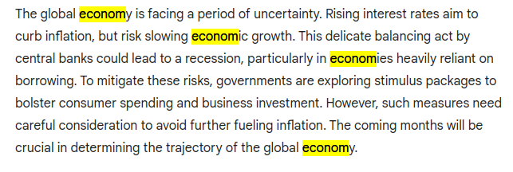
Term Frequency (TF)
TF misst, wie häufig ein Begriff in einem Dokument vorkommt.
Intuition hinter TF: Angenommen, wir haben folgendes Beispiel:
Notes:
The role of Term Frequency (TF) in Inverse Document Frequency (IDF) is to measure how often a word appears in a specific document relative to the total number of words in that document.
TF provides a normalized count of the word's frequency, helping to capture its significance within that context.
This value, when multiplied by IDF, helps determine a term's overall importance in distinguishing that document from others in the corpus, enabling a more nuanced understanding of the content's relevance.

Slide 42
Term Frequency (TF)
Ist das Wort „economy“ in diesem Beispiel wichtig?
Das Wort „economy“ und seine lemmatisierten Formen wurden 4 Mal verwendet.
Kann man also sagen, dass „economy“ eine wichtige Rolle in diesem Text spielt?
Genau hier kommt die Term Frequency (TF) ins Spiel.

Slide 43
Term Frequency (TF)
Formel für Term Frequency (TF) TF(t, d) = (Anzahl der Vorkommen des Terms t im Dokument d) / (Gesamtanzahl der Terme im Dokument d)
Jeder Term in einer Stichprobe erhält ein TF-Gewicht.
Diese Gewichte helfen uns, die Bedeutung eines Wortes innerhalb eines bestimmten Dokuments zu bestimmen.
Diese Gewichte werden wir im praktischen Teil selbst berechnen.

Slide 44
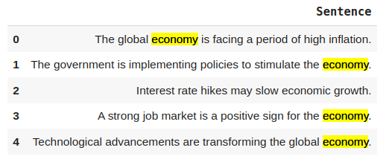
Herausforderungen der TF
Angenommen, wir haben jetzt folgenden Datensatz:
Das Wort „economy“ kommt in jeder Stichprobe mehrfach vor.
Können wir trotzdem noch sagen, dass das Wort „economy“ wichtig ist?

Slide 45
Herausforderungen der TF
Wenn ein Wort in jedem Dokument wiederholt vorkommt, ist es NICHT besonders wichtig, da es zu allgemein verbreitet ist. Es sagt wenig über ein spezielles Dokument aus, weil es in allen Dokumenten vorkommt. Wichtig ist ein Wort nur dann, wenn es in einem oder wenigen Dokumenten häufig auftritt.

Slide 46
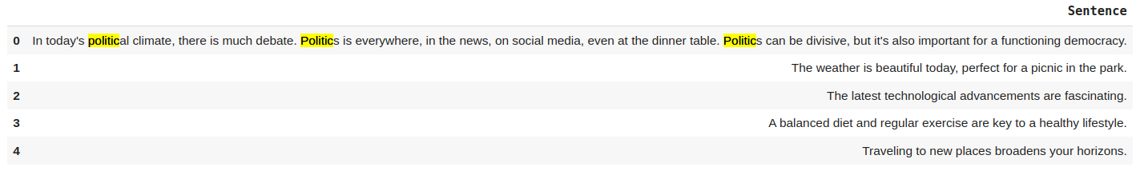
Inverse Document Frequency (IDF)
Die Schwächen von TF machen es notwendig, auch die IDF (Inverse Document Frequency) zu betrachten. Betrachte folgenden Datensatz:
Das Wort „politic“ wurde im ersten Dokument 3 Mal verwendet, aber in den anderen Dokumenten gar nicht.
Deshalb muss es für das erste Dokument eine besondere Bedeutung haben.
Notes:
The role of Inverse Document Frequency (IDF) in TF-IDF is to assess how important a term is across the entire corpus of documents.
It does this by measuring the rarity of the term: a high IDF value indicates that the term is rare and therefore likely to provide more informational value, while a low IDF value suggests the term is common and may not significantly contribute to distinguishing one document from another.
By incorporating IDF, TF-IDF balances the term frequency with its overall significance in the dataset, enhancing the ability to identify meaningful features in the text.

Slide 47
Inverse Document Frequency (IDF)
Wie können wir die allgemeine Bedeutung von „politic“ darstellen?
IDF (Inverse Document Frequency) wird definiert als:
IDF(t) = log( N / df(t) )
N die Gesamtanzahl der Dokumente im Korpus
df(t) die Dokumentenhäufigkeit, also die Anzahl der Dokumente, die den Term „t“ enthalten.

Slide 48
Inverse Document Frequency (IDF)
IDF(t) = log( N / df(t) )
Wobei:
N ist die Gesamtanzahl der Dokumente im Korpus.
df(t) ist die Dokumentenhäufigkeit und gibt an, in wie vielen Dokumenten der Begriff „t“ vorkommt.

Slide 49
TF-IDF
TF (Term Frequency):
Misst die Bedeutung eines Begriffs innerhalb eines einzelnen Dokuments (Samples). Beantwortet die Frage: Wie oft kommt der Begriff in diesem Dokument vor?
IDF (Inverse Document Frequency):
Misst die Bedeutung eines Begriffs im gesamten Korpus.
Beantwortet die Frage: Wie einzigartig oder selten ist der Begriff im Korpus?
TF-IDF:
Das Produkt aus TF und IDF, das sowohl die lokale Bedeutung (innerhalb des Dokuments) als auch die globale Bedeutung (im gesamten Korpus) vereint.
TF-IDF = TF * IDF

